Slide 1
Part 3: Advanced Dynamic Analysis
Chapter 8: Debugging
Chapter 9: OllyDbg

Slide 2
Chapter 8: Debugging
Notes:
2

Slide 3
Debugger
Hardware or software used to examine execution of another program
Disassembler: static snapshot of what code looks like before execution
Debugger: dynamic snapshot of what code does during execution

Slide 4
Types of debuggers
Source-level
Debug while coding
Map machine execution to corresponding source code lines
Allow setting of breakpoints at source-code lines
Assembly-level
Strictly operate at machine instruction level
Main debugger used for malware

Slide 5
Types of debuggers
User mode
Debug one program via another program all in user space
Examples: OllyDbg, gdb
Kernel mode
Debugging a kernel requires a second machine
Must configure target OS to allow kernel debugging
Examples: WinDbg

Slide 6
Debugging functions
Single stepping
One machine instruction or source line at a time
Stepping-over: calls to functions executed all at once before control returned to debugger (next instruction)
Stepping-into: calls to functions followed (enters callee) one machine instruction at a time (step instruction)
Stepping-out: execute until return back to calling function (finish)

Slide 7
Debugging functions
Breakpoints (software)
Set at virtual memory address of instruction or at source line
Allows one to examine the state of the machine at critical execution points
File creation (Listing 8-4, Figure 8-1, p. 171-172, Loc. 4373, 4388)
Encryption (Listing 8-5, Figure 8-2, p. 172-173, Loc. 4399, 4414)
Implemented by overwriting INT 3 (0xcc) into opcode of instruction (Table 8-1, p. 174, Loc. 4425)
Debugger restores overwritten byte upon continue

Slide 8
Debugging functions
Hardware execution breakpoints
Dedicated registers that store virtual addresses
Can be set to break on access, rather than on execution
Memory watchpoints on data (reads or writes)
4 hardware registers (DR0-DR3)
Can be modified by running program!
Malware can disable them
Counter-measure is “General Detect” flag in DR7 that triggers a breakpoint on any mov involving debug registers

Slide 9
Debugging functions
Conditional software execution breakpoints
Break only if a certain condition is met
Example
Break on GetProcAddress function only if address parameter is RegSetValue
Implemented as normal software breakpoint, but debugger checks condition and automatically continues if not met

Slide 10
Handling exceptions
Exceptions pass control to debugger
INT 3, Trap flag in FLAGS register, Division by 0, invalid memory access
Problem
Might interfere with exception handlers that program needs to run
What if my malware is embedded in an INT 3 handler?
First-chance and second-chance exceptions
Debugger (if attached) gets first-chance control
If debugger does not want it, program allowed to handle exception
If program does not handle exception and would crash, debugger gets a second-chance to handle exception
Malware may intentionally trigger first-chance exceptions to determine environment

Slide 11
Modifying execution
Skip functions by changing EIP directly
Invoke functions directly on arguments you choose
Useful in debugging metamorphic malware
Malware programmed to behave differently under different circumstances (e.g. when being debugged, when in a VM, or when located in a nuclear enrichment facility)
Debugger can be set to trace branches of metamorphic code
Locale-based metamorphism (Listing 8-6, p. 177, Loc 4535)

Slide 12
Chapter 9: OllyDbg

Slide 13
OllyDbg
Developed by Oleh Yuschuk
Debugger of choice for malware analysis *and* exploit developers
Many still use OllyDbg 1.1. OllyDbg 2.0 also available. 32-bit only
Purchased by Immunity and forked as Immunity Debugger
Python API support added
Also free

Slide 14
Loading code in OllyDbg
Open executable from within OllyDbg
In-class exercise
Launch OllyDbg and use File=>Open to recreate (Figure 9-2, p. 181, Loc. 4601) for C:\WINDOWS\notepad.exe
4 main windows of OllyDbg
Disassembler, Registers, Stack, Memory dump

Slide 15
Loading code in OllyDbg
Launch executable and attach
In-class exercise
Launch notepad.exe from OllyDbg
Attach OllyDbg to running notepad
Use the View tools to list memory, recreating (Figure 9-4, p. 183) for notepad.exe

Slide 16
Rebasing
Memory locations of Figure 9-4 dynamic
Relocatable code allows libraries to be rebased
Enables libraries to be written independent of each other
Absolute address references modified at load time via .reloc information in PE header
Supports ASLR to thwart malware
In-class exercise (Windows 7 only)
Note the location of notepad's .text section
Relaunch OllyDbg on notepad again
What is the location now?

Slide 17
Threads
Most programs and malware multi-threaded
In-class exercise
Launch Internet Explorer
Attach OllyDbg
View threads via View>Threads
How many threads are there?

Slide 18
Executing code
Debug menu
Run
Breakpoint=>Run to selection
Continue execution until specified instruction
Debug=>Execute till Return
Runs until next return hit (e.g. Finish)
Debug=>Execute till User Code
Run until user program code is reached
Pulls out of library calls
Step into, step over
See previous lecture

Slide 19
Executing code
Malware making a mess out of step-over
p. 187, Loc. 4734
Step over a “call” instruction sets breakpoint to next instruction after call
Malware using a “tail” call might never return
e.g. call 01007568 at 0x010073a4 might never return to xor instruction at 0x01007568

Slide 20
Breakpoints
Software
Unconditional breakpoint (Toggle)
Right-click instruction to find sub-menu to set
Or, double-click opcode
View=>Breakpoints to list

Slide 21
Breakpoints
Conditional breakpoint example
Poison Ivy
Backdoor that reads shellcode commands from socket and executes them
Uses a call to VirtualAlloc to store command
Typical call to VirtualAlloc (Figure 9-7, p. 189, Loc. 4797)
Want to break only on large allocations indicative of a batch of commands (> 100bytes)
Size parameter at [ESP+8]
Set breakpoint at VirtualAlloc entry point if condition [ESP+8] > 100
Breakpoint=>Conditional
Figure 9-8, p. 190, Loc. 4812

Slide 22
Breakpoints
Conditional breakpoints
In OllyDbg with notepad.exe
Right-click and add condition (ecx == 0xFFFF)
View=>Breakpoints (to list)
Hardware
Memory breakpoint (on execution, access, write)
Right-click location in memory window
Debug => Hardware breakpoints (to list)

Slide 23
Loading DLLs
Malware often delivered as DLLs to be injected into other processes
OllyDbg uses loaddll.exe as dummy program
Calls into DllMain function of target DLL
In-class exercise
Generate Figure 9-10, p. 191, Loc. 4856
Open C:\WINDOWS\system32\ws2_32.dll in OllyDbg(32-bit only)
Hit play to initialize DLL
Debug=>Call DLL export to call a particular exported function with custom parameters
Disassembler window automatically updates with disassembled code

Slide 24
Tracing
Recording execution
Call Stack Trace
Open notepad.exe and run
View => Call Stack
Compact view the function call path that has led to your current execution point

Slide 25
Tracing
Recording execution
Run Trace
OllyDbg saves every executed instruction and all changes to registers and flags
In-class: Try tracing on a lab binary
Highlight code to trace
Run Trace=>Add Selection
Execute
View=>Run Trace
Go to red-highlighted traced instructions
- and + to navigate trace and see changes
Or use “Trace Into” and “Trace Over” options to run trace until next breakpoint
Take care to limit size of trace

Slide 26
Tracing
Poison Ivy backdoor example
VirtualAlloc to store commands from C&C server
Stored in heap memory
EIP executes from heap locations
Goal: Begin tracing when EIP points to heap
Step #1: Use Debug=>Set condition to set condition to pause on EIP outside of program segment (Figure 9-11, p. 194, Loc. 4906)
Step #2: Trace Into to execute until condition met
Step #3: Use – key to backup execution to see where entry into shellcode occurred

Slide 27
Exceptions
Exception handling with OllyDbg
User options
Step into exception
Step over exception
Run debugger exception handler
Can also set in Debugging Options to ignore all exceptions (immediately transfer control back to program)

Slide 28
Patching
Modifying program instructions to change behavior
In class
In OllyDbg, modify conditional branch within Lab 3-4 to bypass filename check that deletes file
NOP out call to ShellExecute
At 0x04024EE => Right-click, Binary=>Edit, Fill with NOPs
Copy modifications to new executable via OllyDump (see next slide)

Slide 29
Dumping
Create new binary upon unpacking program
OllyDump plug-in
Find entry point after unpacking and decryption operations of malware performed
Creates a new executable that can be analyzed within IDA Pro
Figure 9-16, p. 198, Loc. 4991

Slide 30
Chapter 9.5: Other debuggers

Slide 31
gdb (the ancient one)
CTF levels for teaching the tool
gdb –tui

Slide 32
Controlling program execution
run
Starts the program
step
Execute until a different source line reached (step into calls)
next
Execute until next source line reached, proceeding through subroutine calls.
continue
Resume program execution until signal or breakpoint.

Slide 33
Controlling program execution
break, del
Set and delete breakpoints at particular lines of code
watch, rwatch, awatch
Data breakpoints
Stop when the value of an expression changes (watch), when expression is read (rwatch), or either (awatch)‏

Slide 34
Displaying data
print
Print expression
Basic
print argc
print argv[0]
print $rsp
print /x addr
‘/x’ says to print in hex. See “help x” for more formats
Same as examine memory address command (x)‏
printf “format string” arg-list
(gdb) printf "%s\n", argv[0]
x (examine)
Examine memory
x /s $rax => print the string at address contained in %rax
x /32xw 0x4006b7 => print 32 words at 0x4006b7 in hexadecimal

Slide 35
Displaying code
disassemble <fn>
Disassemble specific function fn or bytes at an address

Slide 36
Other Useful Commands
where, backtrace
Produces a backtrace - the chain of function calls that brought the program to its current place.
up, down
Change scope in stack
info
Get information
‘info’ alone prints a list of info commands
‘info br’ : a table of all breakpoints and watchpoints
‘info reg’ : the machine registers
quit
Exit the debugger

Slide 37
gdb tui
layout <cmd>
split (creates a split screen with multiple panes)
asm (loads assembly up in a pane)
regs (loads registers up in a pane)
focus <pane>
Puts focus onto a particular pane (cmd, asm, regs)

Slide 38
Walkthrough example
TUI
unalias gdb
gdb
layout split
quit
alias gdb='gdb -tui'
gdb
layout asm
layout regs
Control-X 1
Control-X 2
focus asm
<scroll to first printf>
Breakpoints, stack traces
break *main+47 (at printf)
info br
run
del 1
break printf
run
where
disass main => printf invocation
del 2
Step, next, and finish
break main
run
ni
ni 5
del 3
break *0x80484da
run
si
si 5
finish
Debug stack and function calls
run
p /x $esp
x/8xw $esp
x/s 0x080485c0
x/s 0x08048528
x/s 0x08048530
x/s 0x08048538
ni to the scanf call
Notes:
git clone https://bitbucket.org/wuchangfeng/cs492.git

Slide 39
Walkthrough example
Debug the scanf and the puts
x/s the format string
ni to get integer
x/d the integer -> 0x8048a048
x/s the two puts calls to find Good Job
del 4
Win?
Find compare: *main+81 to *main+92
Break on *main+92
x/d 0x804a024
run
11
continue
run
11
Registers eax and edx
x/d 0x804a048
del 5
Debug via memory watchpoint
break main
watch *0x804a048
run
continue (scanf)
continue (sub)
continue
del 6
Debug via time travel
break *main+73
break *main+92
run
record
continue
reverse-stepi
<return all the way back through to sub>
reverse-continue
<goes back to beginning of trace>
Win!

Slide 40
PEDA
Python Exploit Development Assistance for GDB
https://github.com/longld/peda

Slide 41
rr (deterministic replay via gdb)
Record all CPU state at system calls
Allow debugger to go back in time and play forward
Can get to any process state
Used for debugging browser crashes deterministically
Must run on bare metal to get access to hardware debug registers

Slide 42
QIRA (deterministic replay via QEMU)
Timeless debugging
Record the entire program trace at emulator or VM level
George Hotz, Enigma 2016
https://youtu.be/eGl6kpSajag?t=255
4:15-12:22
Use if you’d like (can do CTF level on it)

Slide 43
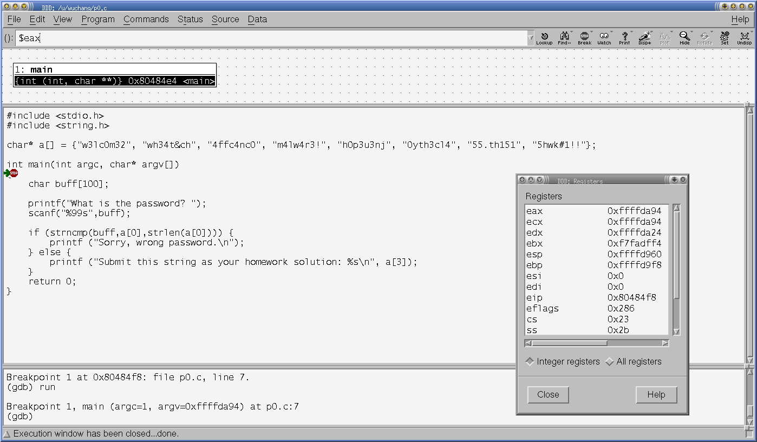
DDD

Slide 44
radare2
Similar to gdb, but with an IDA Pro-like disassembler included
CTF levels for teaching the tool
radare2:gdb akin to Unix:Windows
r2 <binary>
For using it as a disassembler
r2 –d <binary>
For running it in the debugger

Slide 45
Binary Ninja
Lifts binary to a family of intermediate languages similar to LLVM or bytecode
Binary Ninja Intermediate Language (BNIL)
But with flexibility in what is abstracted (multi-stage vs. single-stage)
Tool works on IL
If you like this kind of stuff….
Sophia d’Antoine INFILTRATE 2017
https://vimeo.com/215511922

Slide 46
In-class exercise
Lab 9-2

