Slide 1
C and assembly (motivation)

Slide 2
Why C?
Compared to other high-level languages
Maps almost directly into hardware instructions making code potentially more efficient
Provides minimal set of abstractions compared to other HLLs
HLLs often make programming simpler at the expense of efficiency
Compared to assembly programming
Abstracts out hardware (i.e. registers, memory addresses) to make code portable and easier to write
Provides variables, functions, arrays, complex arithmetic and boolean expressions

Slide 3
Why C?
Used prevalently in critical applications
Operating systems (e.g. Windows, Linux, FreeBSD/OS X)‏
Web servers (apache, Google’s front-end)‏
Web browsers (firefox, chrome)‏
Mail servers (sendmail, postfix)‏
DNS servers (bind)‏
Video games (any FPS)‏
Office apps (Word, Excel, PowerPoint, Adobe)
Graphics card programming (OpenCL GPGPU programming)
Notes:
http://www.techworm.net/2016/10/programming-language-code-used-develop-facebook-google-windows-apples-os-linux-others.html

Slide 4
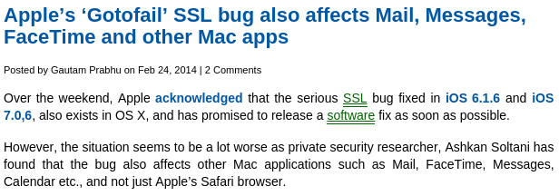
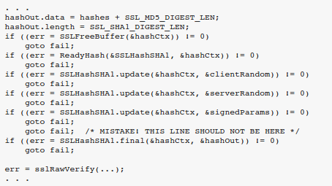
Example
2/2014

Slide 5
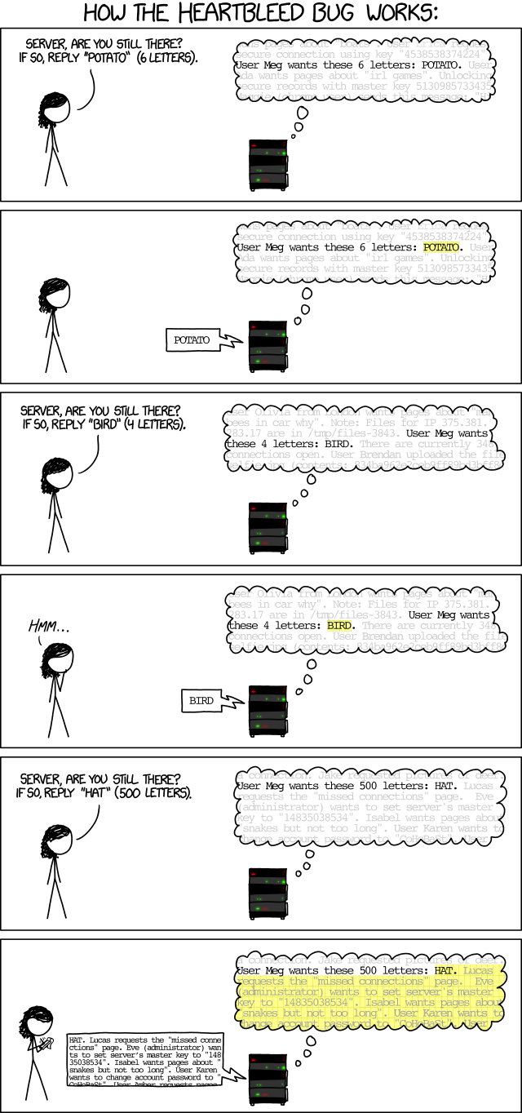
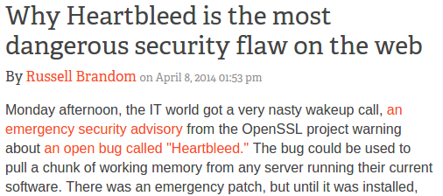
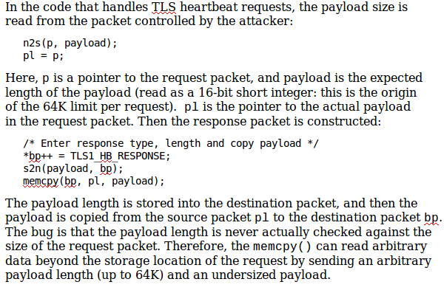
Example
Heartbleed (4/2014)

Slide 6
Why assembly?
Learn how programs map onto underlying hardware
Allows programmers to write efficient code
Allows one to identify security problems caused by programming language and CPU architecture
Enable platform-specific tasks
Access and manipulate hardware-specific registers
Utilize latest CPU instructions
Interface with hardware devices
Reverse-engineer unknown binary code
Identify what viruses, spyware, rootkits, and other malware are doing
Understand how cheating in on-line games work

Slide 7
Example
Meltdown and Spectre

Slide 8
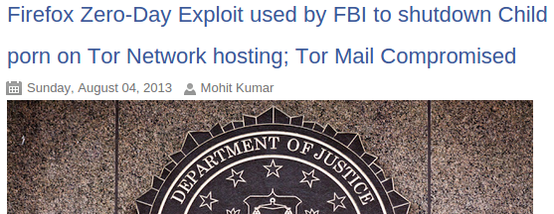
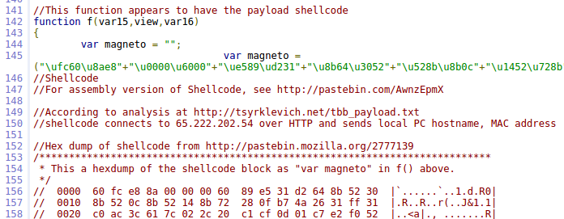
Example
FBI Tor Exploit (Playpen) (8/2013)
8/2014

Slide 9
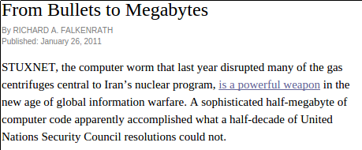
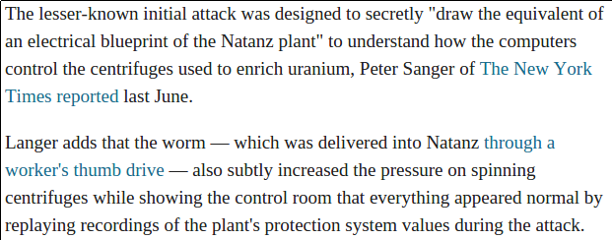
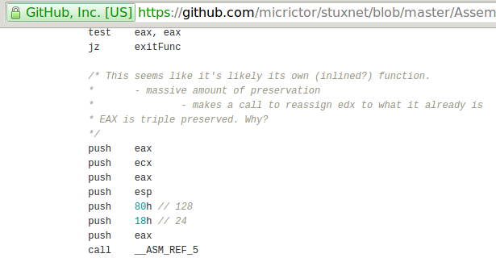
Example

Slide 10
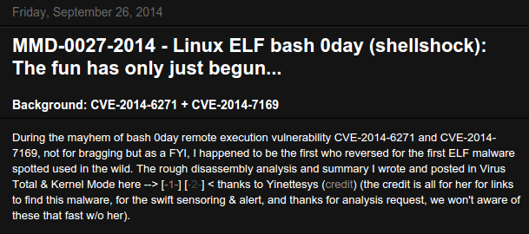
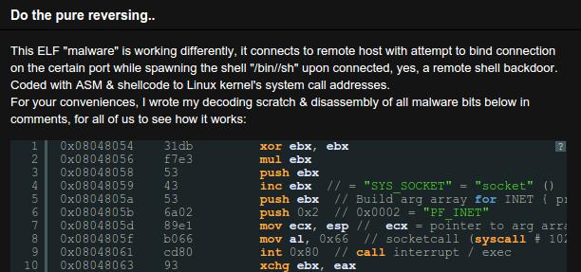
Example
Shellshock

Slide 11
C

Slide 12
The C Programming Language
One of many programming languages
C is an imperative, procedural programming language
Imperative
Computation consisting of statements that change program state
Language makes explicit references to state (i.e. variables)‏
Procedural
Computation broken into modular components (“procedures” or “functions”) that can be called from any point
Contrast to declarative programming languages
Describes what something is like, rather than how to create it (e.g. HTML, SQL)
Implementation left to other components (e.g. a web browser or database server)

Slide 13
The C Programming Language
Simpler than higher-level languages such as C++, C#, Java
No support for
Objects
Managed memory (e.g. garbage collection)
Array bounds checking
Name spaces
Simple support for
Typing
Structures
Basic utility functions supplied by libraries linked in at compile-time or run-time
libc, libpthread, libm
Low-level, direct access to machine memory (pointers)‏
Easier to write bugs, harder to write safe programs, typically faster
Language features updated with ANSI-C standard

Slide 14
The C Programming Language
Compilation down to machine code as in C++
Compiled, assembled, linked via gcc
Compared to interpreted languages…
Python/JavaScript
Commands executed by run-time interpreter
Interpreter runs natively
Java
Compilation to virtual machine “byte code”
Byte code interpreted by virtual machine software
Virtual machine runs natively

Slide 15
C variables
Named using letters, numbers, some special characters
By convention, not all capitals
Must be declared before use
C is statically typed
Contrast to typical dynamically typed scripting languages (Python, PHP, JavaScript)
Variable declaration format
<type> <variable_name>;
Optional initialization using assignment operator (=)
C statements end with ‘;’
Examples
int foo = 34;
float ff = 34.99;

Slide 16
Integer data types and sizes
char – single byte integer
8-bit character, hence the name
Strings implemented as arrays of char and referenced via a pointer to the first char of the array
short – short integer
16-bit (2 bytes) not used much
int – integer
32-bit (4 bytes) used in IA32
long – long integer
64-bit (8 bytes) in x64 (x86-64)

Slide 17
Floating point types and sizes
float – single precision floating point
32-bit (4 bytes)
double – double precision floating point
64 bit (8 bytes)

Slide 18
Data Type Ranges for x86-64
Type Size Range
char 1 -128 to 127
short 2 -32,768 to 32,767
int 4 -2,147,483,648 to 2,147,483,647
long 8 -2⁶³ to 2⁶³-1
(-9,223,372,036,854,775,808 to …)
float 4 3.4E+/-38
double 8 1.7E+/-308

Slide 19
Constants
Integer literals (constants)
Decimal constants directly expressed (1234, 512)
Hexadecimal constants preceded by '0x' (0xFE , 0xab78)
Character constants
Single quotes to denote ( 'a' )
Corresponds to ASCII numeric value of character 'a'
String Literals
Double quotes to denote ("I am a string")
"" is the empty string

Slide 20
Arrays
char foo[80];
An array of 80 characters (stored contiguously in memory)
sizeof(foo) = 80 × sizeof(char)= 80 × 1 = 80 bytes
int bar[40];
An array of 40 integers (stored contiguously in memory)
sizeof(bar)= 40 × sizeof(int)= 40 × 4 = 160 bytes

Slide 21
Structures
Aggregate and organize related data of arbitrary types
typedef unsigned long time_t;
typedef unsigned long suseconds_t;
struct timeval {
time_t tv_sec;
suseconds_t tv_usec;
}; /* <== DO NOT FORGET the semicolon */
struct timeval curtime;
curtime.tv_sec = 100;
curtime.tv_usec = 0;

Slide 22
C operators
Logical relation operators (return 0 or 1)
< > <= >= == != && || !
Bit-wise boolean operators
& | ~ ^
Arithmetic operators
+ - * / % (modulus)
int foo = 30;
int bar = 20;
foo = foo + bar;
Equivalent shortened form
foo += bar;

Slide 23
Increment and Decrement
Comes in prefix and postfix flavors
i++ ++i
i-- --i
Makes a difference in evaluating complex statements
A major source of bugs
Prefix: increment happens before evaluation
Postfix: increment happens after evaluation
When the actual increment/decrement occurs is important to know about
What are the values of these expressions for i = 3 ?
i++*2
++i*2

Slide 24
C control flow
Conditional execution
Expression delineated by ( )
if (x == 4)‏ y = 3; /* sets y to 3 if x is 4 */
Code blocks delineated by curly braces { }
For blocks consisting of more than one C statement
if ( ) { } else { }
while ( ) { }
do { } while ( );
for(i=1; i <= 100; i++) { }
switch ( ) {case 1: … }

Slide 25
Other control-flow statements
Keywords and their semantics
continue; control passed to next iteration of do/for/while
break; pass control out of code block
return; exits function it is used in immediately and returns value specified

Slide 26
Function calls (static)
Function or its prototype must be declared before its use
Calls to functions typically static (resolved at compile-time)
void print_ints(int a, int b)‏ {
printf("%d %d\n",a,b);
}
int main(int argc, char* argv[]) {
int i=3;
int j=4;
print_ints(i,j);
}

Slide 27
Example 1
#include <stdio.h>
int main(int argc, char* argv[])‏
{
/* print a greeting */
printf("Hello world!\n");
return 0;
}
$ gcc -o hello hello.c
$ ./hello
Hello world!
$

Slide 28
Breaking down the code
#include <stdio.h>
Include the contents of the file stdio.h
Case sensitive – lower case only
No semicolon at the end of line
Required in order to supply function definition for printf call
int main(…)‏
The OS calls this function when the program starts running.
printf(format_string, arg1, …)‏
Call function from libc library
Prints out a string, specified by the format string and the arguments.

Slide 29
Passing arguments
main has two arguments from the command line
int main(int argc, char* argv[])‏
argc
Number of arguments (including program name)‏
argv
Pointer to an array of string pointers
argv[0]: = program name
argv[1]: = first argument
argv[argc-1]: last argument
Example: find . –print
argc = 3
argv[0] = "find"
argv[1] = "."
argv[2] = "-print"

Slide 30
Example 2
#include <stdio.h>
int main(int argc, char* argv[])‏
{
int i;
printf("%d arguments\n", argc);
for(i = 0; i < argc; i++)‏
printf(" %d: %s\n", i, argv[i]);
return 0;
}

Slide 31
Example 2
$ ./cmdline The Class That Gives CS Its Zip
8 arguments
0: ./cmdline
1: The
2: Class
3: That
4: Gives
5: CS
6: Its
7: Zip
$

Slide 32
C quirks

Slide 33
Pointers
Unique to C
Variable that holds an address in memory.
Address in memory contains another variable.
All pointers are 8 bytes (64-bits) for x86-64
Every pointer has a type
Type of data at the address (char, int, long, float, double)

Slide 34
Pointer operators
Declared via the * operator in C variable declarations
Assigned via the & operator
Valid on all lvalues
Anything that can appear on the left-hand side of an assignment

Slide 35
Pointer operators
Dereferenced via the * operator in C statements
Returns the data that is stored in the memory location specified by the pointer
Type of pointer determines what is returned when "dereferenced"
Example
int x = 1, y = 2;
int *ip = &x;
y = *ip; // y is now 1
*ip = 0; // x is now 0
Dereferencing uninitialized pointers:
What happens?
int *ip;
*ip = 3;
Segmentation fault
Pointers must always be pointing to allocated memory space!

Slide 36
Using Pointers‏
long i; /* data variable */
long *i_addr; /* pointer variable */
i_addr = &i; /* & = address operator */
i
i_addr
?
?
0x4300
0x4308
i
i_addr
?
4300
0x4300
0x4308

Slide 37
Using Pointers‏
*i_addr = 32; /* dereference operator */
long j = *i_addr; /* dereference: j is now 32 */
i
i_addr
32
4300
0x4300
0x4308
i
i_addr
j
32
4300
32
0x4300
0x4308
0x4310

Slide 38
Using Pointers‏
i = 13; /* but j is still 32 */
i
i_addr
j
13
4300
32
0x4300
0x4308
0x4310

Slide 39
Pointers and arrays in C
Assume array z[10]
z[i] returns i^{th} element of array z
&z[i] returns the address of the i^{th} element of array z
z alone returns address the array begins at or the address of the 0th element of array z (&z[0])
int* ip;
int z[10];
ip = z; /* equivalent to ip = &z[0]; */

Slide 40
Pointer arithmetic
Done based on type of pointer
char* cp1;
int* ip1;
cp1++; // Increments address by 1
ip1++; // Increments address by 4
Often used to sequence arrays
int* ip;
int z[10];
ip = z;
ip += 3;
*ip = 100
How much larger is ip than z?
Which element of z is set to 100?
12
z[3] = 100

Slide 41
Function call parameters
Function arguments are passed “by value”.
What is “pass by value”?
The called function (callee) is given a copy of the arguments.
What does this imply?
The callee can’t alter a variable in the caller function, only its copy given through arguments.

Slide 42
Example 1: swap_1
void swap_1(int a, int b)‏
{
int temp;
temp = a;
a = b;
b = temp;
}
If x=3,y=4, then after swap_1(x,y);
A1: x=4; y=3;
A2: x=3; y=4;

Slide 43
Example 2: swap_2
void swap_2(int *a, int *b)‏
{
int temp;
temp = *a;
*a = *b;
*b = temp;
}
If x=3,y=4, then after swap_2(&x,&y);
A1: x=3; y=4;
A2: x=4; y=3;

Slide 44
Call by value vs. reference in C
Call by reference implemented via pointer passing
void swap(int *px, int *py) {
int tmp;
tmp = *px;
*px = *py;
*py = tmp;
}
Swaps the values of the variables x and y if px is &x and py is &y
Uses integer pointers instead of integers
Otherwise, call by value...
void swap(int x, int y) {
int tmp;
tmp = x;
x = y;
y = tmp;
}

Slide 45
Assignments and expressions
In C, assignment is an expression
x = 4 has the value 4
if (x == 4)‏ y = 3; /* sets y to 3 if x is 4 */
if (x = 4)‏ y = 3; /* always sets y to 3 */
while ((c=getchar()) != EOF)‏

Slide 46
Tricky expressions
https://freedom-to-tinker.com/blog/felten/the-linux-backdoor-attempt-of-2003/

Slide 47
JPL’s Power of Ten rules
C is difficult to code securely in
For safety-critical, embedded applications (IoT, driverless cars, etc), use these rules to improve safety of code
Rule #1
Restrict all code to very simple control flow constructs
Avoid using goto statements, setjmp or longjmp constructs, and recursion
Easier to verify, better code clarity, acyclic call graph for integrity checks
Rule #2
Ensure loops have a fixed upper bound that can be statically proven to prevent runaway code
Rule #3
Do not use dynamic memory allocation after initialization
Predictability in performance, avoidance of memory leaks and memory corruption bugs in allocation/deallocation code

Slide 48
JPL’s Power of Ten rules
Rule #4
No function should be longer than what can be printed on a single sheet of paper (60 lines)
Each function should be a logical unit that is understandable and verifiable as a unit
Rule #5
Code should average a minimum of two assertions per function to check for anomalous conditions that should never happen
Verify pre- and post-conditions of functions, parameters, return values and loop invariants
Assertion failures should return error conditions to caller
Defect rate of 1 every 10-100 lines of code. Assertions help catch them

Slide 49
JPL’s Power of Ten rules
Rule #6
Data objects should be declared at the smallest possible level of scope
Data-hiding keeps values from being referenced or corrupted from elsewhere
Allows easier diagnosis of errors
Rule #7
Return value of non-void functions should be checked by calling function
Validity of parameters should be checked inside each function
Common to ignore return value checks on many C library calls
Exceptions should be justified

Slide 50
JPL’s Power of Ten rules
Rule #8
Limit preprocessor use to inclusion of header files and simple macros. Macros should expand into complete syntactic units
Limit the use of conditional compilation directives to one or two to limit number of versions of code that need to be tested
Reduce obfuscated code
Rule #9
Restrict the use of pointers with no more than one level of dereferencing. Function pointers should be avoided
Pointers easily misused, are hard to follow and analyze for static analyzers
Must have clear flow of control and function call hierarchies to reason about safety of code
Rule #10
Compile all code with all compiler warnings enabled -Wpedantic
Code should pass with no warnings
Modern, static source code analyzers can catch a large percentage of errors with few false positives

Slide 51
Extra
https://sayat.me/wu4f

Slide 52
Constant pointers
Used for static arrays
Square brackets used to denote arrays
Symbol that points to a fixed location in memory
Can change characters in string ( amsg[3] = 'x'; )
Can not reassign amsg to point elsewhere (i.e. amsg = p)
char amsg[ ] = “This is a test”;
This is a test\0

